Slide 1
Evolutionary Development Models

Slide 2
Evolutionary/Incremental Development Model
Evolutionary model is also referred to as the successive versions model and sometimes as the incremental model.
In Evolutionary model, the software requirement is first broken down into several modules (or functional units) that can be incrementally constructed and delivered .

Slide 3
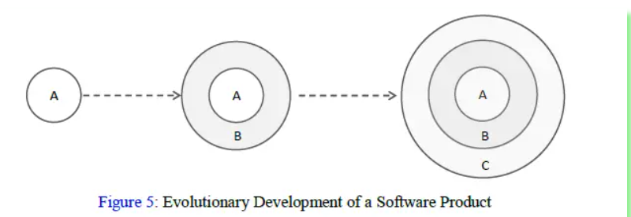
The development first develops the core modules of the system. The core modules are those that do not need services from the other modules.
The initial product skeleton is refined into increasing levels of capability by adding new functionalities in successive versions.
Each successive version/model of the product is a fully functioning software capable of performing more work than the previous versions/model.

Slide 4
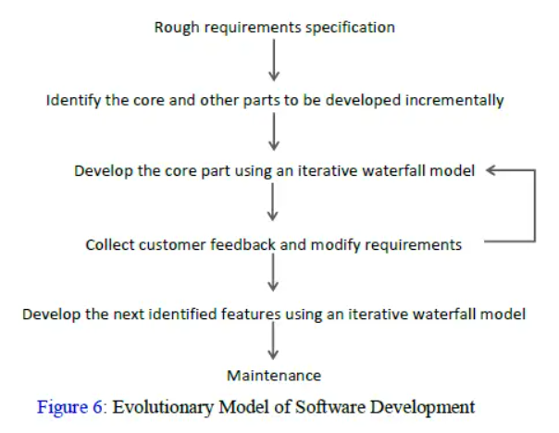
Often, evolutionary model is used when the customer prefers to receive the product in increments so that he can start using the different features as and when they are developed rather than waiting all the time for the full product to be developed and delivered.
Often, evolutionary model is used when the customer prefers to receive the product in increments so that he can start using the different features as and when they are developed rather than waiting all the time for the full product to be developed and delivered.

Slide 5
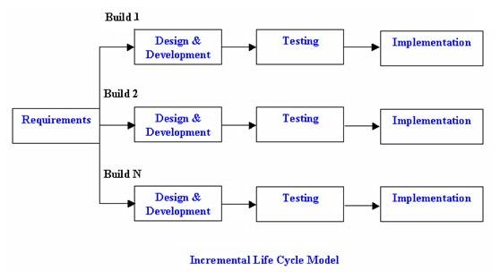
.
.

Slide 6
Advantages
Generates working software quickly and early during the software life cycle.
This model is more flexible – less costly to change scope and requirements.
It is easier to test and debug during a smaller iteration.
In this model customer can respond to each built.
Lowers initial delivery cost.
Easier to manage risk because risky pieces are identified and handled during it’s iteration.
Error reduction
Incremental resource deployment

Slide 7
Disadvantages
Needs good planning and design.
Needs a clear and complete definition of the whole system before it can be broken down and built incrementally.
Total cost is higher than waterfall.
Ad hoc design
Feature division into incremental parts can be non-trivial

Slide 8
When to use
This model can be used when the requirements of the complete system are clearly defined and understood.
Major requirements must be defined; however, some details can evolve with time.
There is a need to get a product to the market early.
A new technology is being used
Resources with needed skill set are not available
There are some high risk features and goals.
The evolutionary model is well-suited to use in Object-oriented software development projects.

